Slide 1
Design Thinking Phase 1:
Immerse & Research Plan

Slide 2
Shopping Habits in a Post-Pandemic World Among 20-24 Year Old Students Living Independently
By: Vennela Gajjala, Haoyang Li, Mounika Tarigopula, Noah Placke
Team S.A.C.S (Students Against Comic Sans)

Slide 3
Questions Related:
Goal: To better understand how shopping habits of students in their early 20s living alone have transformed due to the pandemic
Insights we hope to gain:
Understand what products and services people value most during this pandemic
How people value money in a time where income can be uncertain
How have attitudes and emotions towards shopping and its experience changed overtime
What are the positives and negatives about people's experiences shopping during the pandemic
What additional value do people want their shopping experience to bring them
Notes:
Vennela
Focus just on insights
Exec Sum.
People not customers
Get more specific
Go through stories
Activity in interview, more structure

Slide 4
Research Approach
Number of Participants: 12 (3 per researcher)
Recruitment Strategy: Through researcher personal connections
Order of Research: Photo Elicitation → Concentric Circles → Personal Interview
Research Environment: All research will be conducted virtually over zoom
Structure of Research:
Participants will send pictures to the research team before they meet with a researcher
Next, they will fill out the Concentric Circles with the researcher over Zoom
Lastly they will be interviewed using a standardized list of question (researchers ask follow ups as needed)

Slide 5

College Kid Chester
Picture
Demographics:
Age: 22
Income: Middle Class
Location: Texas
Education: Some College
Relationship Status: Not Married
Employment: Full Time Student
Description: Student committed full time to studying at a University in the state of Texas who values their independence.
Personality:
Organized
Health-conscious
Spend-wise
Studious
Enjoys eating at home
Concerned about pandemic safety
Socialite
Independent
Story: Chad is a college kid who has lived away from their parents for at least a year. Chad is money conscious but doesn’t mind spending a few bucks on the nicer things when needed. He continued to live away from home during the pandemic. Since the pandemic became more serious, Chad wonders what he should spend his money on as times change and the future is uncertain.
Notes:
Noah
Explore more

Slide 6
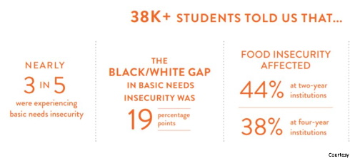
Why College Kid Chester?
Previous studies inspired us:
Students as a whole were severely affected by the pandemic in terms of education, housing etc
Unaware of the extent of change in their lives over this time
Seeking solutions to alleviate anxiety about day to day tasks?
Make a health and pandemic conscious college student feel safe shopping and make sure they have access to all products
Questions to Ask:
Who do you live with? Alone or roommates? How many?
How do you currently pay for the things you need day to day?
What are your biggest concerns during the pandemic?
How do you feel about the future?
Notes:
Credit graphic or edit

Slide 7
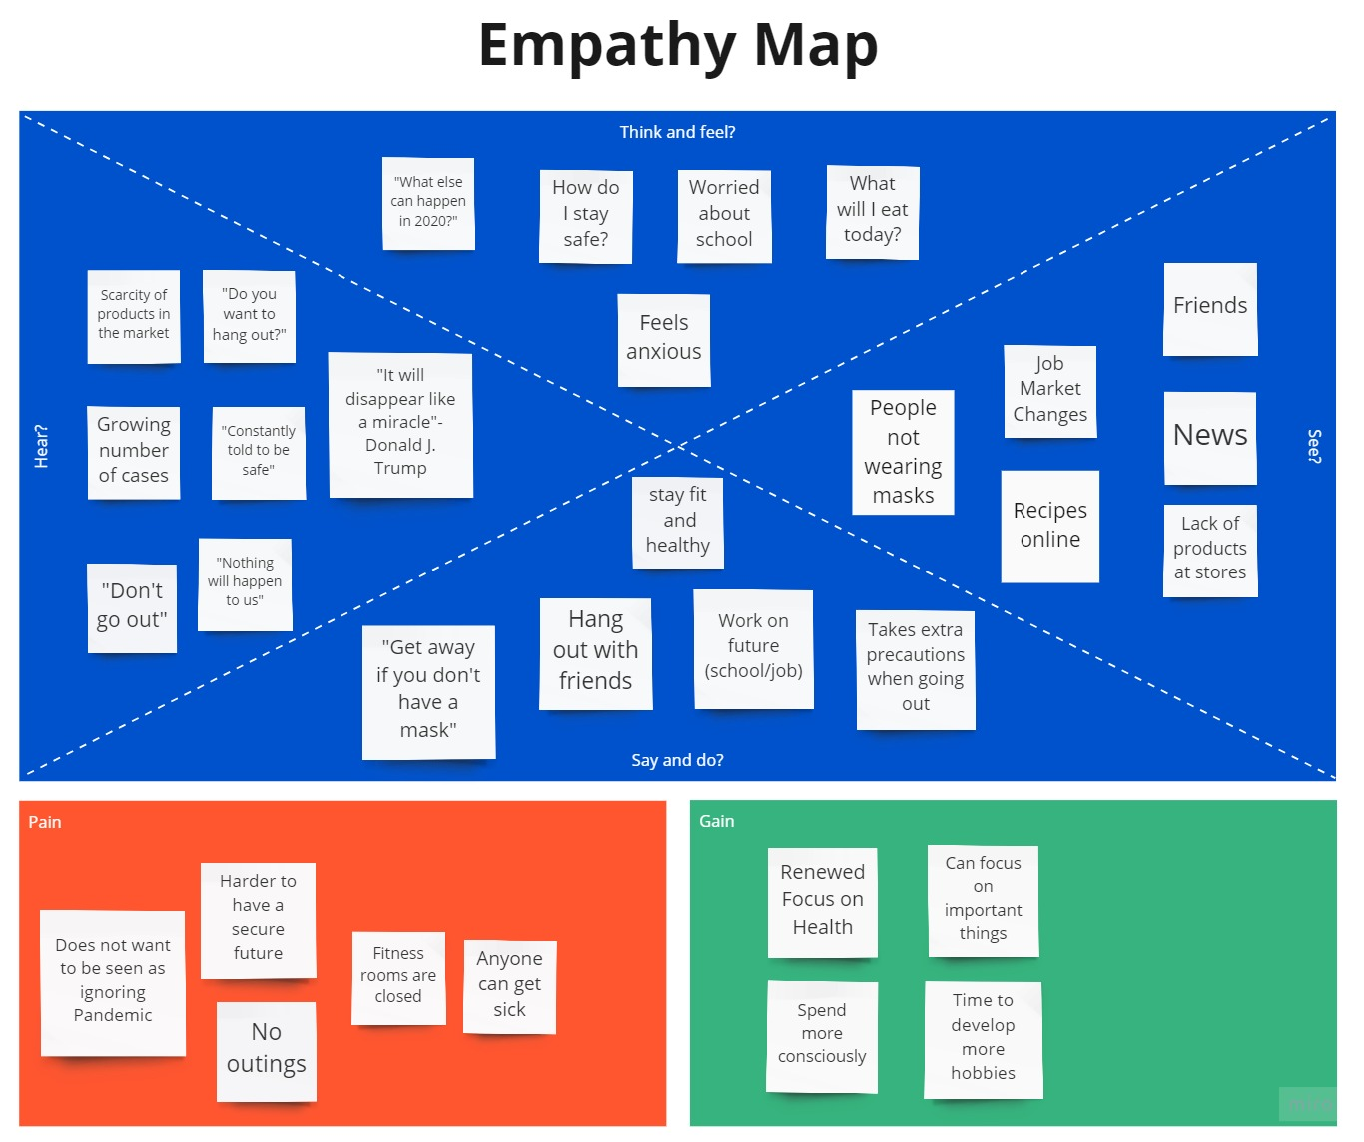

Slide 8

College Kid Chester Timeline
8:30 am- Wake up and Workout
9:30 am- Shower and get Ready
10:30 am- 1:30pm - Class
1:30 pm-2:30 pm - Lunch
2:30 pm - 6: 30 pm - Homework
6:30 pm- 8:30 pm- Miscellaneous tasks, Grocery Shops if needed
8:30 pm- 9:30 pm- Dinner
11:30 pm- Sleep

Slide 9
Life in a Pandemic for Chester
Pandemic life is boring without being able to see my friends or go out
I worry a lot about if I will get COVID-19
Topics of Concern- Job, School, Safety of my family, friends and I
I feel a lot of anxiety over daily tasks
I have taken steps to be more cautious when I go out
Things we aim to Learn about:
How does grocery shopping affect other areas of their lives?
What are the biggest pain points and opportunities they see during this time?
What emotions do they feel as they go through their normal routine?

Slide 10

Research Structure
Optimized Route
Photos - have participants send photos first to get baseline understanding of what has been purchased recently
Concentric Circle - fill out needs/wants when shopping to compare what they think is important vs. what is actually bought (photos)
Interview - End with interview to ask questions about previous findings or bring up new questions that arise. Deeper understanding of participant found with interview

Slide 11
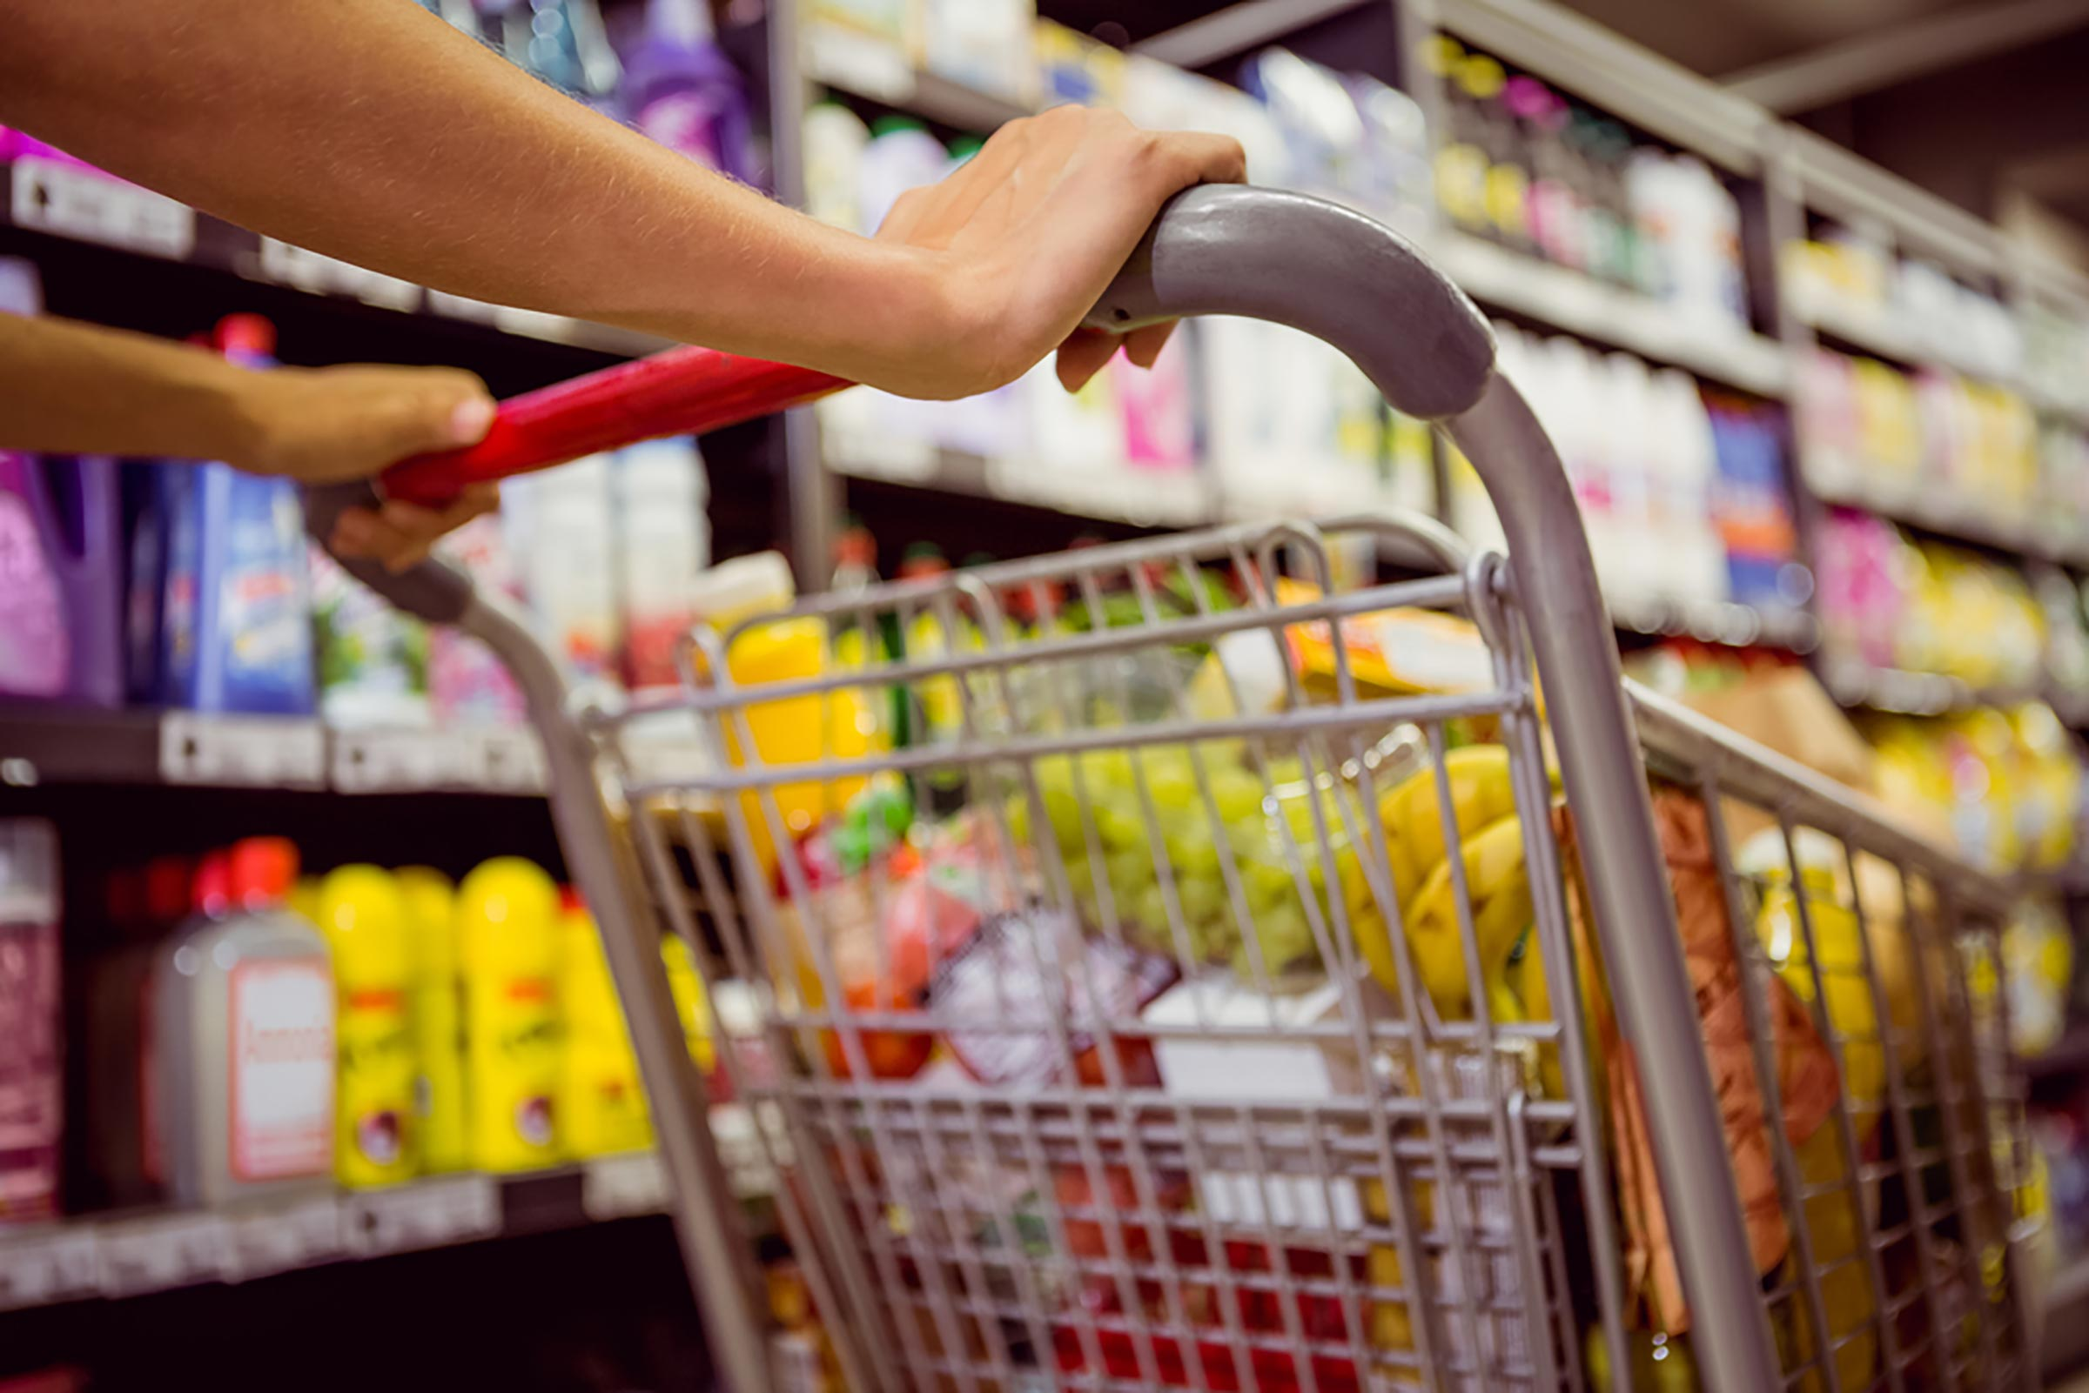
Research Structure
Needs Being Met
Our research is structured in a way that each part will build on the former. Pictures are a great way to start because it creates a sense of connection to our participants and their personal shopping life. After we see what they have, we can ask what they think is most important and can compare those answers with what we saw via photos. We meet our needs of knowing the reality of what is bought and the thinking behind the purchasing. Finally the interview is where we can ask deeper questions behind their actions of the previous two methods.

Slide 12
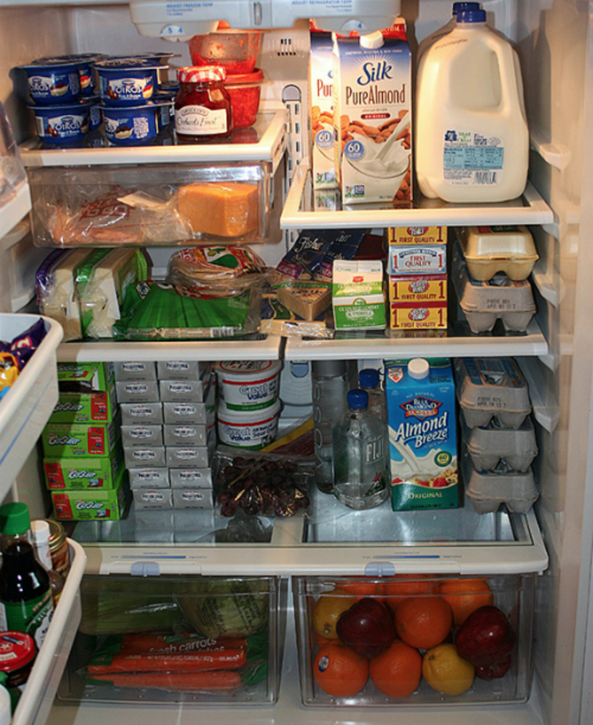
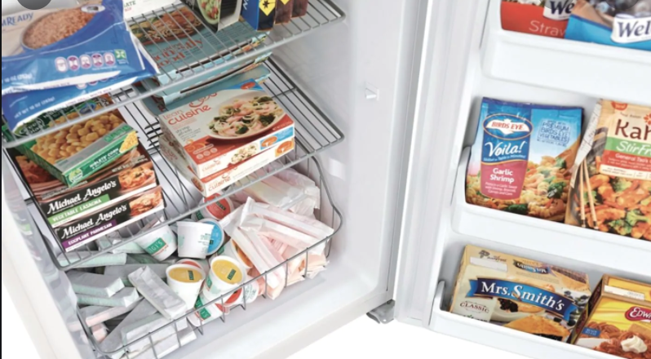
Method 1: Photo Elicitation
Collect pictures from the participants of their fridge,freezer, grocery receipt and pantry
Understand whether the participant is buying essential needs or ending up buying due to scarcity
Details on products why they think it is necessary
Any items which they thought of buying but didn't
Based on the insights get a picture on participants way of life
Notes:
Mounika
More detail
Add Questions

Slide 13
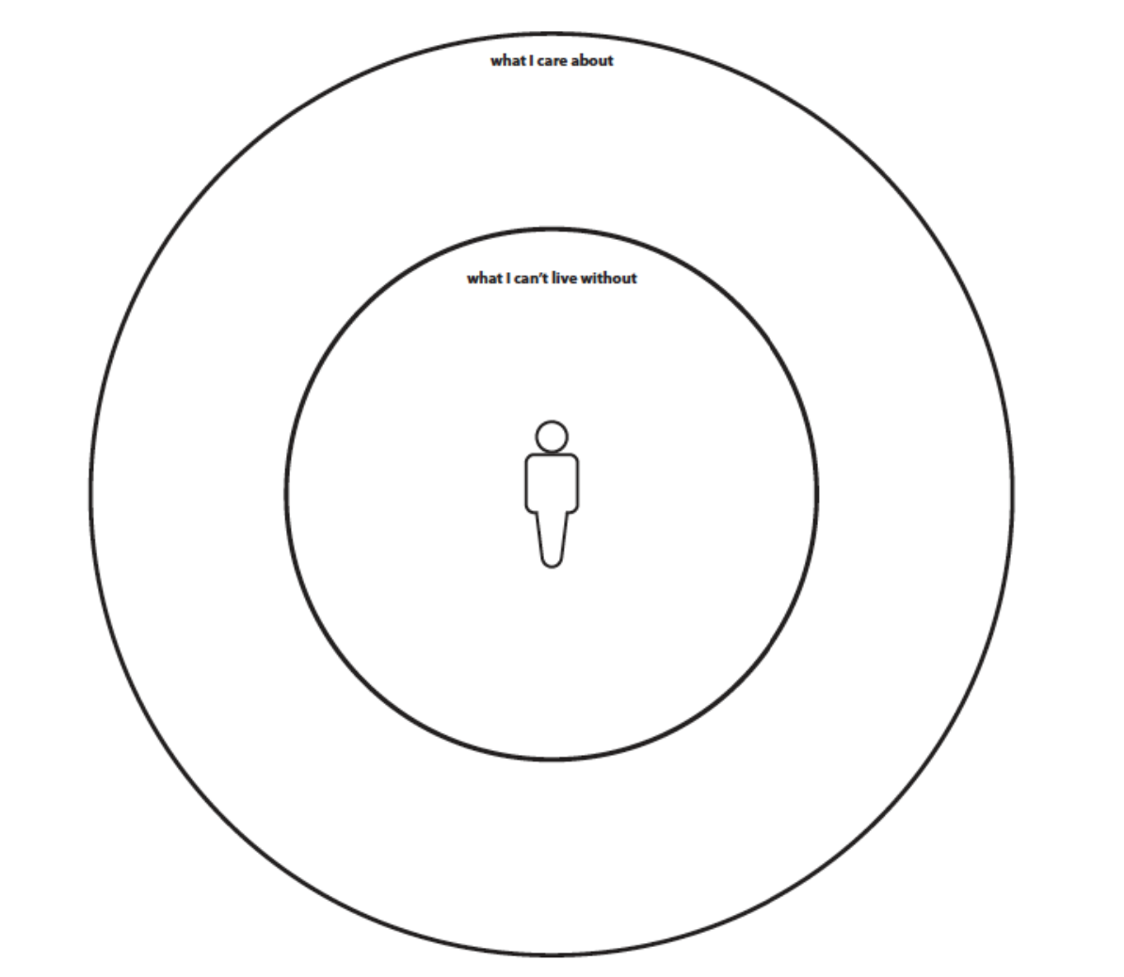
Method 2 : Concentric Circles
Conduct twice (before and after pandemic)
How participants behave in present environment and situations.
How participants value different products during and before pandemic
Does participant’s shopping get affected due to financial change over pandemic
Participants’ behavior towards e-shopping before and after pandemic
Understand what products participant thinks are essential now and the story behind it
Notes:
Haoyang

Slide 14

Method 3: Personal Interviews
Focus on people’s stories about their experiences shopping before and during the pandemic
Understand their most positive and uncomfortable experiences shopping and why
Capture the emotions at each point in the process
What are the biggest changes they have faced from pre/post pandemic
How have perceptions about expenses changed
Notes:
Vennela
Structure
Learn consumers point of view towards shopping before and now. Reasons for the changes
Obtain information about their emotions , experiences and lifestyle changes
Does peers pressure affect you in any shopping habits
Observe body language and learn more about the mindset of customers

Slide 15
Concerns & Limitations
How might participant profiles be skewed?
Financial background of participants can have a great affect on their necessity
Peer pressure in shopping can affect participants’ shopping style
Lifestyles and eating habits can cause different demand on goods
Culture background of participants can lead them to different place to shop
In what ways might your approach be biasing the insights?
Researchers personal relationship with participants which might lead to some bias
People may not remember the stuff they bought- Memory vs Facts
Participants my hiding information from Researchers that they don’t want to talk about

Slide 16
Ways to Mitigate
Ensuring confidentiality of the research
Standardized Questions and Approach
Second Member form research team reviewing participant answers to avoid researcher bias
Ask the people who provided the data whether your interpretations seem to be representative of their beliefs

Slide 17

Reflection
Sample size is small at only 12 people. A larger sample is necessary to gain a more accurate insight to what is really going on
Our group works very well together and have hit virtually no roadblocks and have agreed on the processes and minutia
Concerned about not being able to do anything about the problem we uncover. We may be able to see what’s wrong but fixing it is another story
Realized how important it is for the research process to flow correctly. Finding out which methods to use put into perspective that you can’t just shotgun random methods to gain insight

